Slide 1

Phase 2 Trial Evaluating the Effect of Dexpramipexole on Eosinophil Biomarkers and Lung Function in Asthma
Professor Salman Siddiqui, Clinical Professor of Airways Disease, University of Leicester, UK

Slide 2
Conflict of interest disclosure
X I have the following real or perceived conflicts of interest that relate to this presentation:
Affiliation / Financial interest | Commercial company
Grants/research support: | NIHR Biomedical Research Centre, Leicester, UK
Honoraria or consultation fees: | Chiesi, Astra Zeneca, GSK, ERT medical, Owlstone Medical, CSL Behring, Knopp Biosciences, Boehringer Ingeheim
Participation in a company sponsored bureau: | None
Stock shareholder: | None
Spouse / partner: | None
Other support / potential conflict of interest: | None
This event is accredited for CME credits by EBAP and speakers are required to disclose their potential conflict of interest. The intent of this disclosure is not to prevent a speaker with a conflict of interest (any significant financial relationship a speaker has with manufacturers or providers of any commercial products or services relevant to the talk) from making a presentation, but rather to provide listeners with information on which they can make their own judgments. It remains for audience members to determine whether the speaker’s interests, or relationships may influence the presentation. The ERS does not view the existence of these interests or commitments as necessarily implying bias or decreasing the value of the speaker’s presentation. Drug or device advertisement is forbidden.

Slide 3
Dexpramipexole background
Benzothiazole molecular structure
Originally developed in ALS
Failed to meet efficacy endpoint in Phase 3 ALS trial, however blood eosinophil lowering noted¹
Clinical development pivoted to develop as an oral eosinophil lowering drug in eosinophilic asthma and other eosinophil-associated disorders
Significant tissue lowering of eosinophils in nasal polyps², bone marrow and target organs³ in CRSwNP and HES respectively

Slide 4
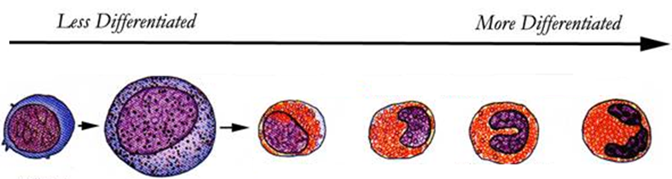
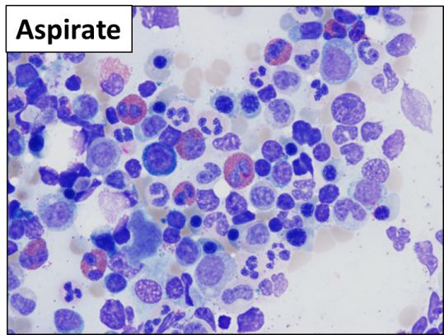
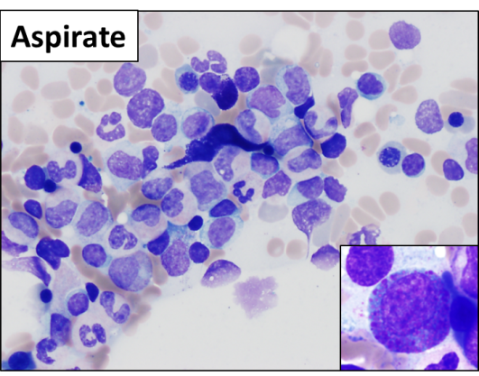
Dexpramipexole eosinophil lowering driven by eosinophil maturation inhibition
Less Differentiated
More Differentiated
Point of maturation inhibition
X
Eosinophilic myeloblast
Eosinophilic
promyelocyte
Eosinophilic
myelocyte
Eosinophilic
meta-
myelocyte
Eosinophilic
band cell
Mature
eosinophil
Pre-treatment
On treatment
Mature
eosinophil
Eosinophilic
promyelocyte
Panch et al. Blood. 2018

Slide 5
Trial objectives
To evaluate the safety and efficacy of dexpramipexole in subjects with poorly controlled moderate to severe eosinophilic asthma with and absolute eosinophil count (AEC) ≥0.30x10⁹ /L
Establish dexpramipexole dose response to inform future clinical development

Slide 6

EXHALE Phase 2 study design
Study Design
100 subjects, 28 sites (U.S.), GINA 3-5
12 weeks Primary Assessment Phase
Parallel group, randomized, double-blind
Endpoints
  Primary: AEC lowering at 12 weeks
  Secondary
    FEV1
    ACQ-6
    Safety, adverse events
Placebo
Dexpramipexole 75 mg/day
Dexpramipexole 150 mg/day
Dexpramipexole 300 mg/day
Placebo
Dexpramipexole 75 mg/day,
Dexpramipexole 150 mg/day
Dexpramipexole 300 mg/day
Eosinophil Recovery
Phase
Run-in Phase
Primary Assessment Phase
Study
Drug:
Open-label placebo
Dexpramipexole 300 mg/day, 150 mg/day, 75 mg/day or placebo
Study Visits:
Study Week:
-2
0
2
4
6
8
12
16/18
20
24
Screening
Baseline/
Randomization
Primary Outcome Visit
End of Study Visit
Primary Endpoint: Change in blood eosinophil count
From baseline to week 12

Slide 7
EXHALE baseline demographics
Demographics | Statistics | Placebo (N = 27) | Dexpramipexole 75 mg/day (N = 22) | Dexpramipexole 150 mg/day (N = 26) | 300 mg/day dexpramipexole (N = 28)
Age (years) | Mean (SD) | 45·8 (12·89) | 46·6 (13·41) | 44·5 (15·46) | 44·6 (12·53)
Sex
Female | n (%) | 17 (63·0%) | 11 (50·0%) | 14 (53·8%) | 12 (42·9%)
Race
White | n (%) | 21 (77·8%) | 17 (77·3%) | 16 (61·5%) | 22 (78·6%)
Black or African American | n (%) | 4 (14·8%) | 4 (18·2%) | 6 (23·1%) | 6 (21·4%)
Asian | n (%) | 1 (3·7%) | 1 (4·5%) | 2 (7·7%) | ---
Eosinophil count (per µL) | Geo Mean (+/- SE) | 382 (364, 401) | 404 (365, 447) | 374 (353, 397) | 438 (409, 470)
Pre-BD FEV1, % predicted | Mean (SE) | 62·7 (1·48) | 59·0 (2·31) | 63·6 (1·90) | 62·3 (1·95)
ACQ-6 score | Mean (SD) | 2·3 (0·83) | 2·3 (0·90) | 1·9 (0·68) | 2·13 (0·89)
Exhaled Nitric Oxide (ppb) | Median (IQR) | 30·0 | 32·0 | 24·5 | 26·0
ICS/LABA dose
Low-dose ICS + LABA | n (%) | 10 (37·0%) | 8 (36·4%) | 4 (15·4%) | 3 (10·7%)
Medium-dose ICS + LABA | n (%) | 14 (51·9%) | 9 (40·9%) | 15 (57·7%) | 19 (67·9%)
High-dose ICS + LABA | n (%) | 3 (11·1%) | 5 (22·7%) | 7 (26·9%) | 6 (21·4%)
Met ERS/ATS severe asthma criteria | n (%) | 5 (18.5%) | 6 (27.3%) | 8 (30.7%) | 7 (25%)

Slide 8
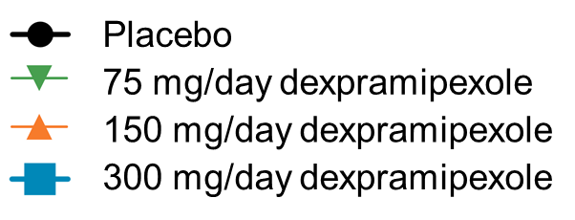
Eosinophil count, ratio to Baseline
Week 12 primary endpoint
Primary Assessment Phase
Eosinophil Recovery Phase
p-values vs. placebo:
1.0
p=0.019
p=0.0014
p<0.0001
1.0
0.5
Eosinophils, ratio to Baseline
Eosinophils, ratio to Baseline
0.5
0.25
0
0.125
Placebo
75 mg/day
150 mg/day
300 mg/day
0
4
8
12
16
20
24
Study visit (days)
Week 12 log-linear dose response trend: p<0.0001
Population: Efficacy
Geometric LS mean, ±95% CI
Population: Efficacy
Geometric mean, ±SE

Slide 9
Significant, dose-dependent tissue EPX lowering at Week 12
p=0.0187
100
p=0.0198
ns
10
1
Nasal EPX, W12 to BL ratio
0.1
0
Placebo
75 mg/day
150 mg/day
300 mg/day
Kruskal-Wallis test, median values shown
EPX measured as ng EPX/mg protein

Slide 10
EXHALE secondary endpoints at Week 12
 | Placebo | Dexpramipexole 75 mg/day | Dexpramipexole 150 mg/day | Dexpramipexole 300 mg/day
Pre-bronchodilator FEV₁ (mL)
Number of subjects analysed | 17 | 18 | 21 | 24
Change from Baseline, LSM | 55.7 | 178 | 55.5 | 238
Difference versus Placebo, LSM (95% CI) |  | 123 (-105, 350) | -0.18 (-221, 221) | 182* (-35.5, 400)
p-value vs. placebo |  | 0.29 | 1.0 | 0.10
Exhaled nitric oxide FeNO (ppb)
Number of subjects analysed | 17 | 17 | 20 | 23
Change from Baseline, LSM | 3.4 | -6.8 | -3.1 | -4.9
Difference versus Placebo, LSM (95% CI) |  | -10.2 (-23.4, 3.0) | -6.53 (-19.1, 6.1) | -8.24 (-20.6, 4.1)
p-value vs. placebo |  | 0.13 | 0.31 | 0.19
ACQ-6 score
Number of subjects analysed | 25 | 22 | 24 | 28
Change from Baseline, LSM | -0.4 | -0.4 | -0.4 | -0.7
Difference versus Placebo |  | -0.03 (-0.56, 0.51) | -0.05 (-0.58, 0.48) | -0.26 (-0.77, 0.25)
p-value vs. placebo |  | 0.92 | 0.86 | 0.31
*p<0.05 vs PBO at week 8, week 16/18

Slide 11
Conclusions
Dexpramipexole demonstrated a dose dependant and large depletion of blood (80% relative to PBO) and tissue (89% relative to PBO) eosinophils/EPX in asthma at a dose of 300 mg daily
Dexpramipexole improved pre bronchodilator FEV₁ at the 300 mg dose
No significant safety signals were observed in the EXHALE trial
EXHALE Phase II data supports further clinical development of Dexpramipexole as a novel, first in class, potent, oral, anti-eosinophilic agent in asthma

Slide 12
References
1. Cudcowicz ME et al, Lancet Neurol 2013
2. Laidlaw TM et al, Laryngoscope 2019
3. Panch SR et al, Blood 2018

